Slide 1


LENDING CLUB CASE STUDY
By – Suraj Kumar Panigrahi

Slide 2
Business Objective
Understand how consumer attributes and loan attributes influence the tendency of default
Understand driving factors for default
Utilize the analysis for applicant portfolio and risk assessment during new loans

Slide 3
Problem Solving Process
Understanding the Dataset
Shape of the data
Fields in the data
Data Cleaning
Clean NA values
Clean singular values
Data Standardization
Fill in values for empty cells using
EDA
Univariate
Segmented Univariate
Bivariate

Slide 4
Data Preparation Process
Removed unnecessary and empty columns
Removing outliers
Removing duplicate columns
Handling missing values
Creating derived attributes

Slide 5
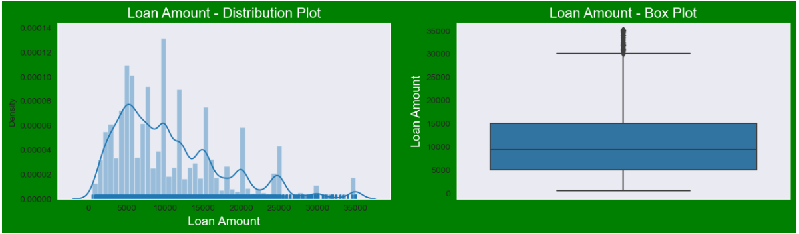
Loan Amount Analysis
Observations
Most loans range from 5000 – 15000
Average loan amount is around 10000

Slide 6
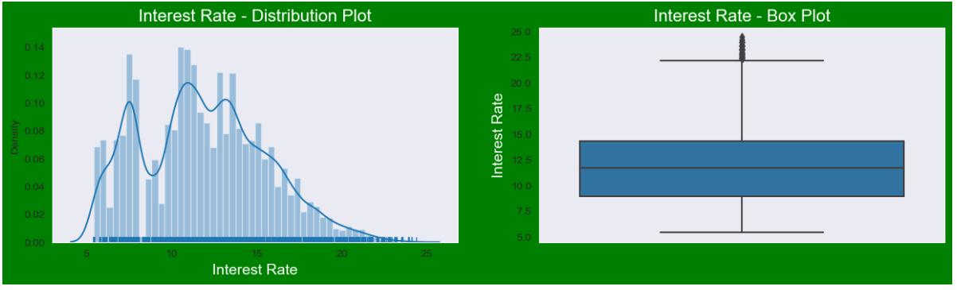
Interest Rate Analysis
Observations
Most interest rates range from 9% – 14%
Average interest rate is around 12%

Slide 7
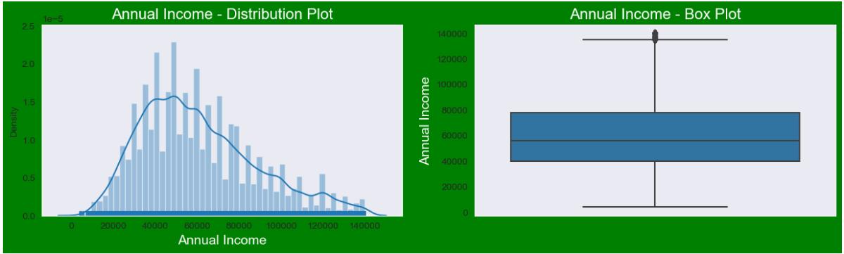
Annual Income Analysis
Observations
Annual income ranges from 40K – 80K
Average interest rate is around 57K

Slide 8
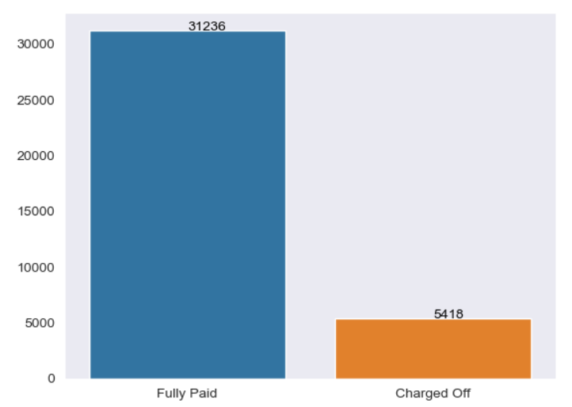
Loan Status Analysis
Observations
Around 14% of the total loans were charged off

Slide 9
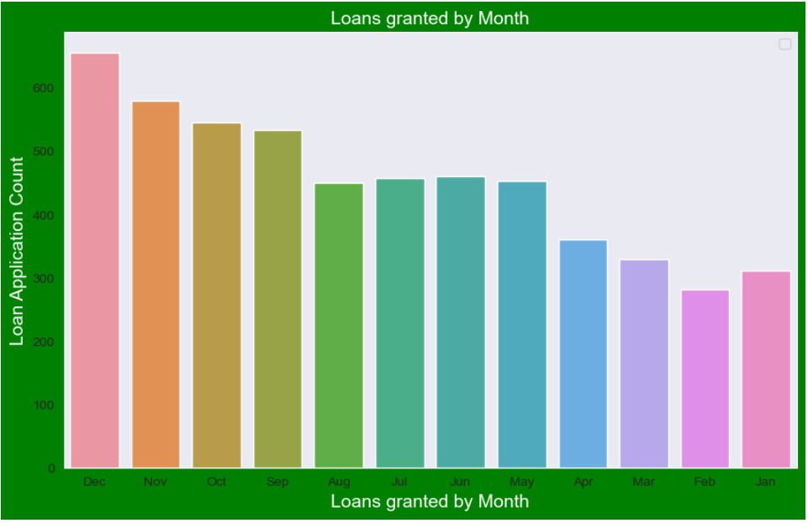
Loan Approval Analysis By Month
Observations
Highest number of loan application were approved in the month of December

Slide 10
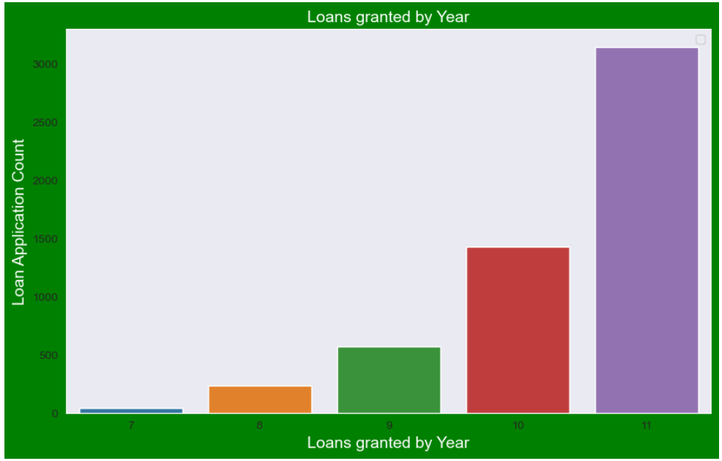
Loan Approval Analysis By Year
Observations
Highest number of loan application were approved in 2011

Slide 11
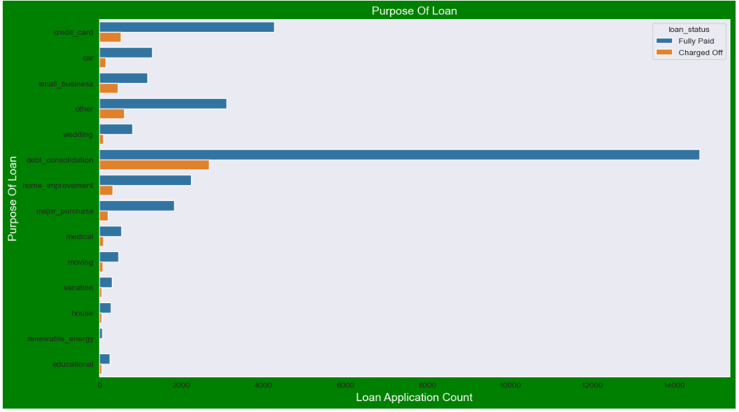
Loan Status Analysis by Purpose of loan
Observations
Maximum number of applications were approved for debt consolidation purposes followed by credit card payments
The number of charged-off loans were highest for debt consolidation

Slide 12
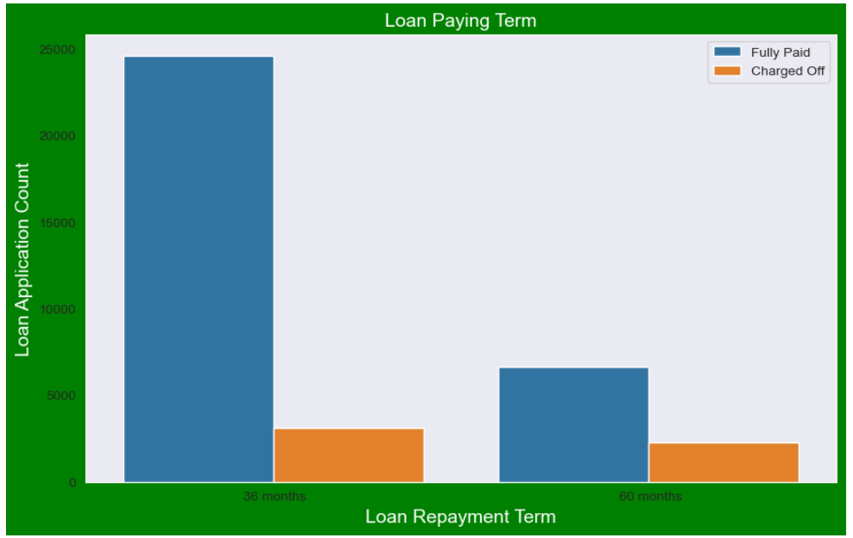
Loan Status Analysis by Tenure of loan
Observations
Most loan repayment happens when tenure is 36 months
The percentage of charged-off applications is high when loan tenure is 60 months

Slide 13
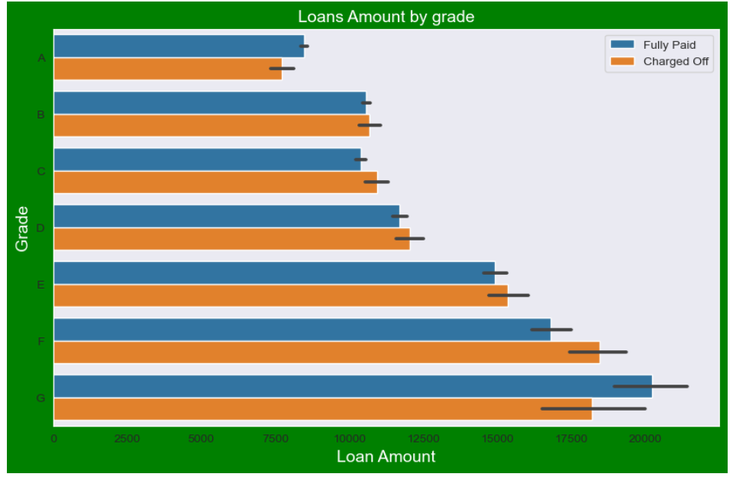
Loan Status Analysis by Tenure of loan
Observations
Most loan applications charged-off is for grade ‘F’
Almost 50% of the loans granted to grade ‘B’ is charged-off.

Slide 14
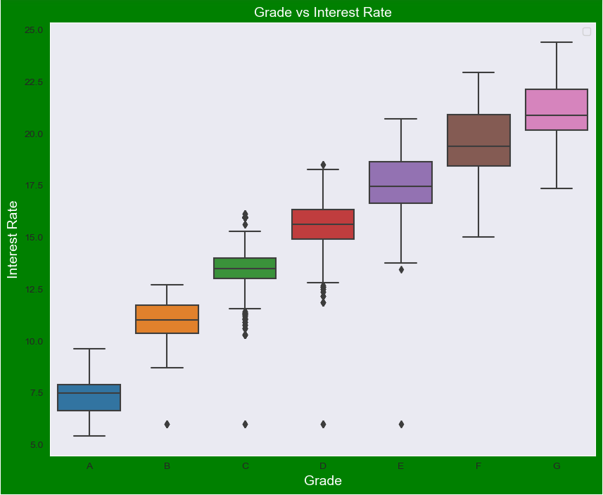
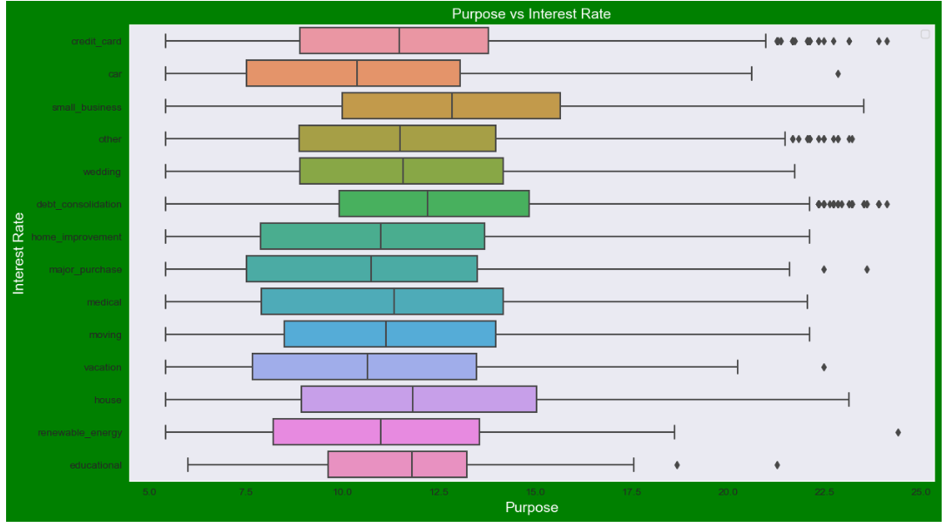
Interest Rate Analysis based on Purpose and Grade
Observations
Average interest rates are high for small business.
Average Interest rates increases with increase in grade from A to G

Slide 15
Conclusion
Loans having higher interest have a greater risk of default. Applicant purpose and home ownership are to be verified before approval.
Loans applied for the purpose of “DEBT CONSOLIDATION” tend to be at risk of default.
Loans applied for 60 months tenure are at greater risk to be defaulted compared to loans applied for 36 months
Applicants in grade ‘F’ and having income in the range of 15K-20K tend to default.

